Slide 1
Graduate students as mentors to teach scientific research ethics to pre-university students: Outreach program
Pedagogical Demonstration:
Priming the Pump –
Empowering Engineering and Business Faculty and Graduate Students to Teach Ethics in their Classes.
Carlos Ríos-Velázquez, PhD
UPR-Mayagüez

Slide 2
Graduate Education in Research Ethics for Scientist and Engineers
(GERESE)
Graduate Awareness
Workshop
Moral Deliberation
Workshop
Case Analysis
Workshop
Ethics
Banquet
Outreach program

Slide 3

Outreach program
Main Objectives
To relate liberty as a human being atribute.
To define and distinguish between ethics and moral.
To define and identify the terms plagiarism, fabrication and falsification.
4. To define, and describe conflict of interest and mentorship.
5. To relate ethics with environmental protection and the use of humans and animals in research.

Slide 4
Workshop organization
Pre-test (15 – 20 min)
Power point presentation (1 hr and 30 min).
Development of videos about cases in research ethics by the students. (1 hr)
IV. Presentation of the videos and group discussions. (45 min)
V. Post-test (15-20min)

Slide 5
Assessment
Open questions → close questions → Research ethics
Case
Perception knowledge Analysis

Slide 6
Some of the videos prepared by
The UPR-Mayagüez
College students

Slide 7
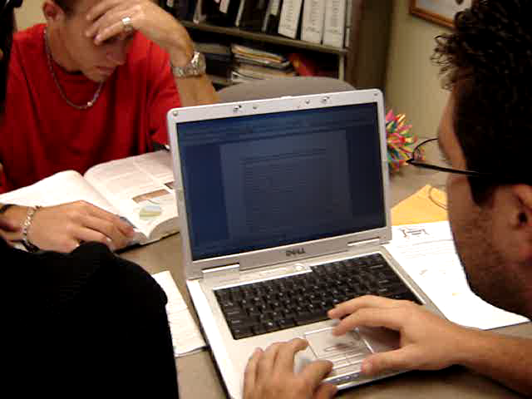
Plagiarism

Slide 8
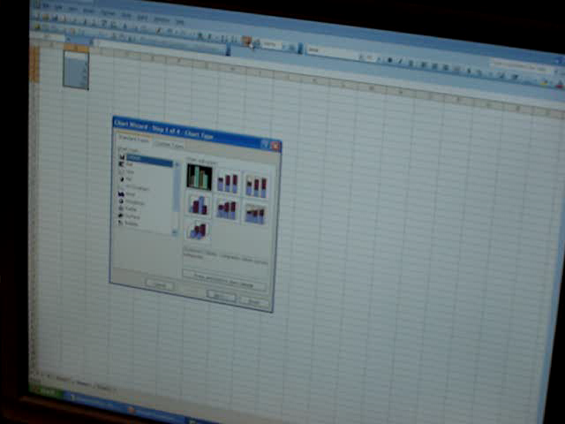
Fabrication

Slide 9
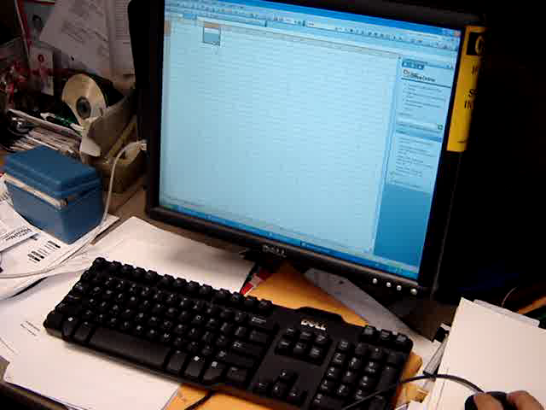
Falsification

Slide 10
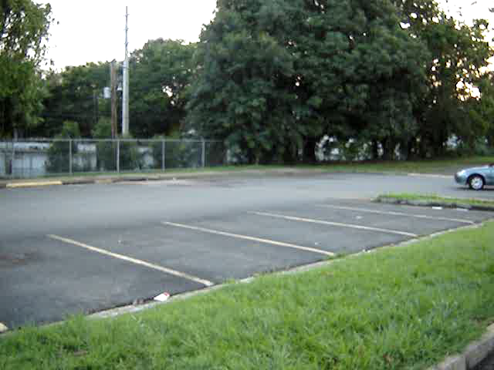
Environment

Slide 11
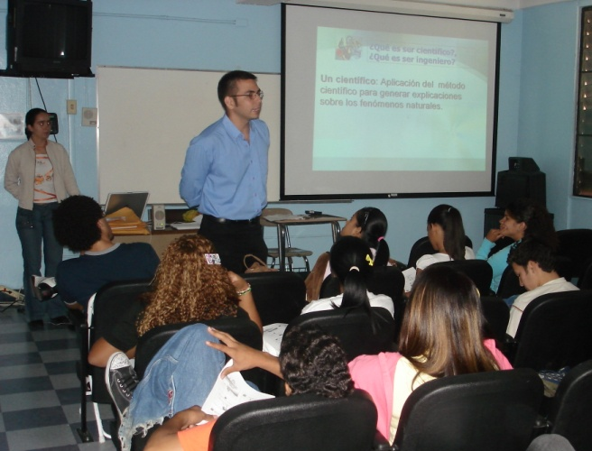
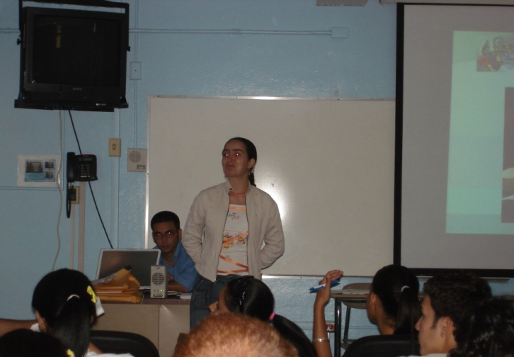
The mentors
Mr. Morgan Echeverry
Miss Erica Jaramillo

Slide 12
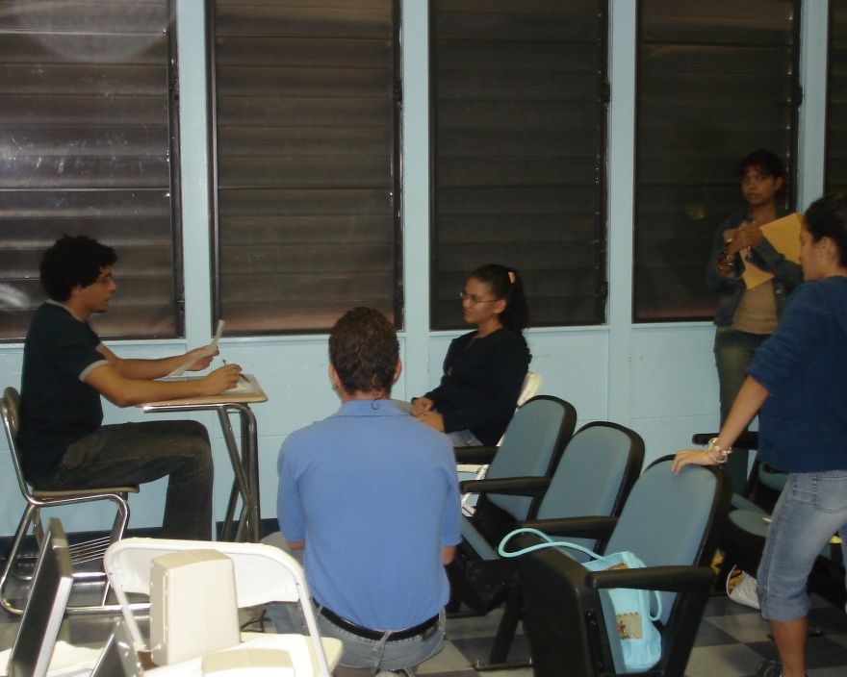
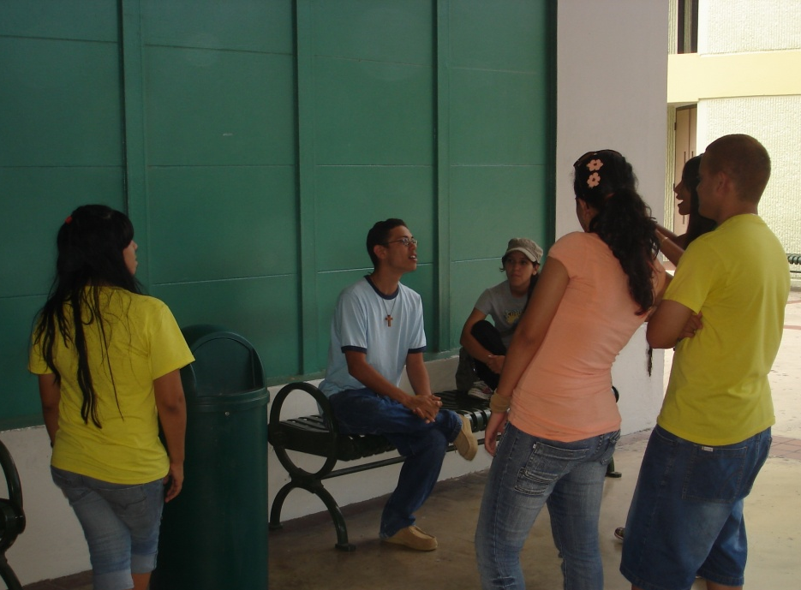
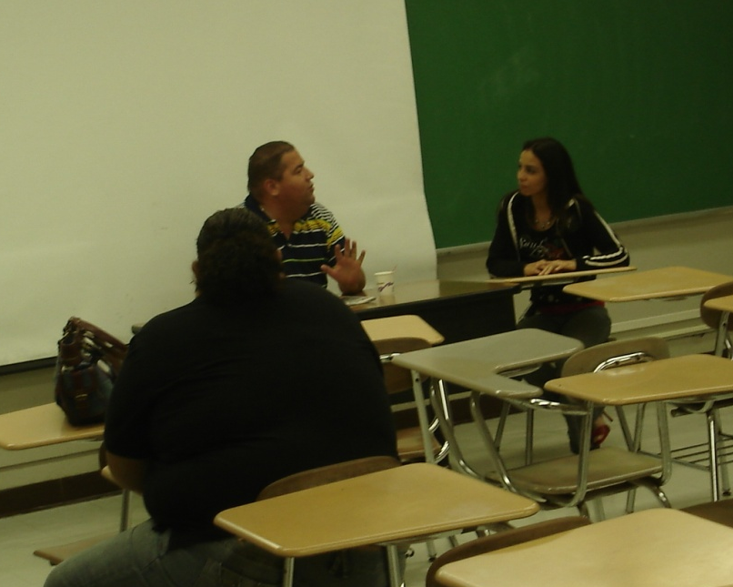
The participants

Slide 13
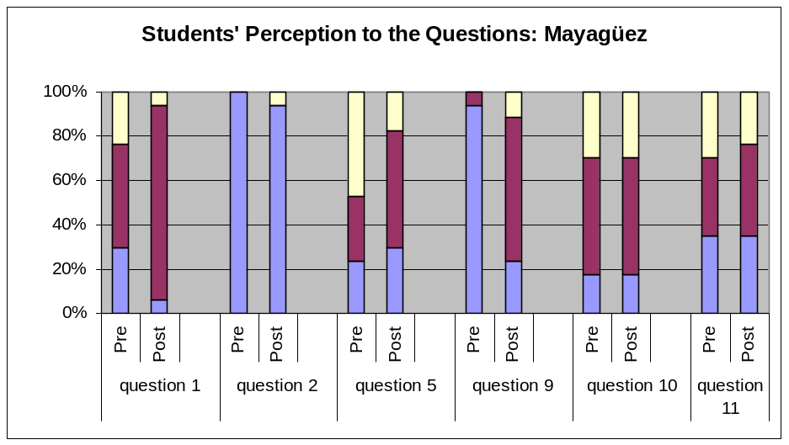
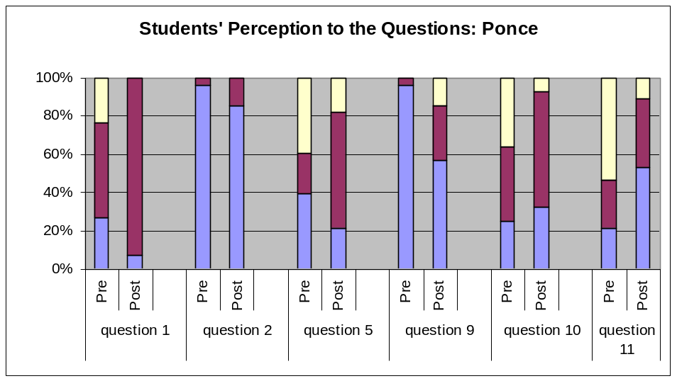

The Assessment: perception

Slide 14
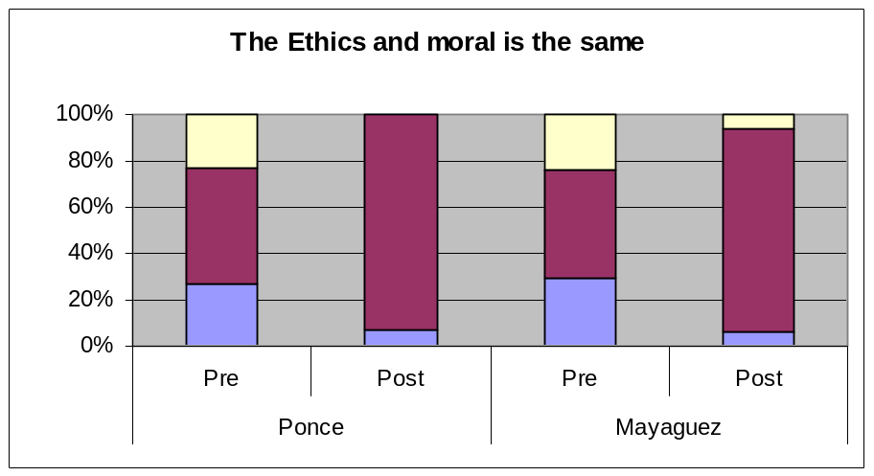
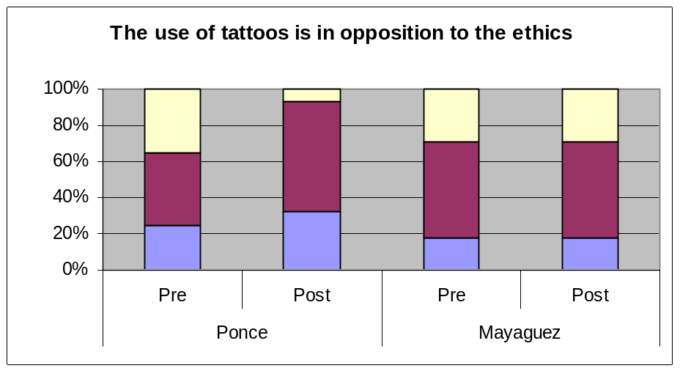
The Assessment: perception

Slide 15
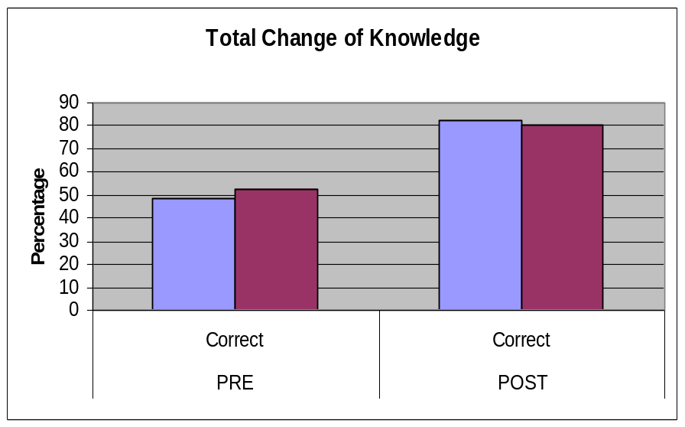
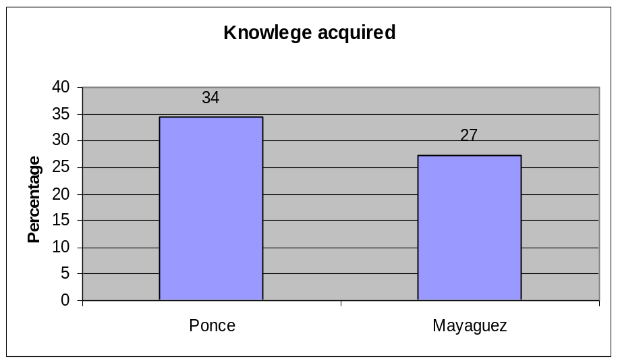
The Assessment: knowledge

Slide 16
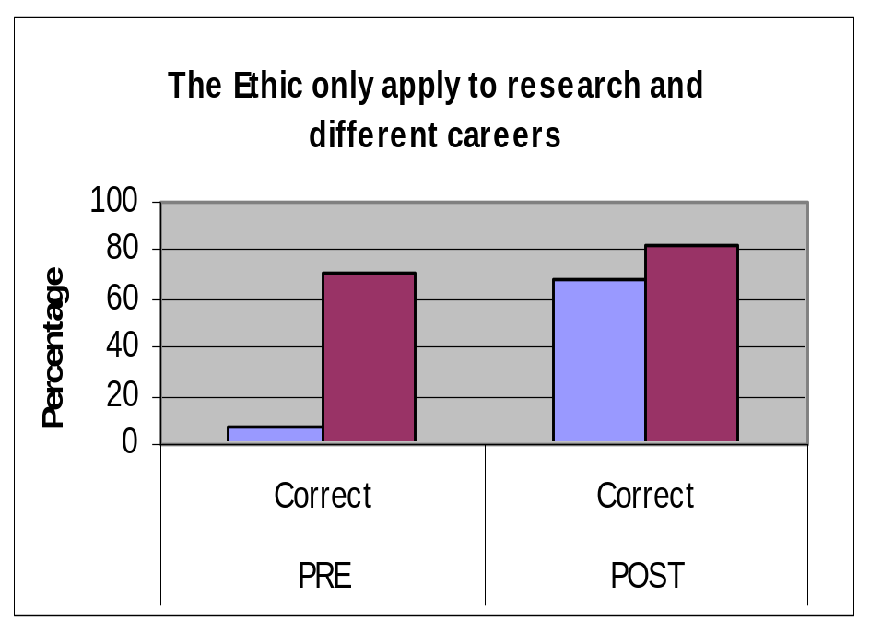
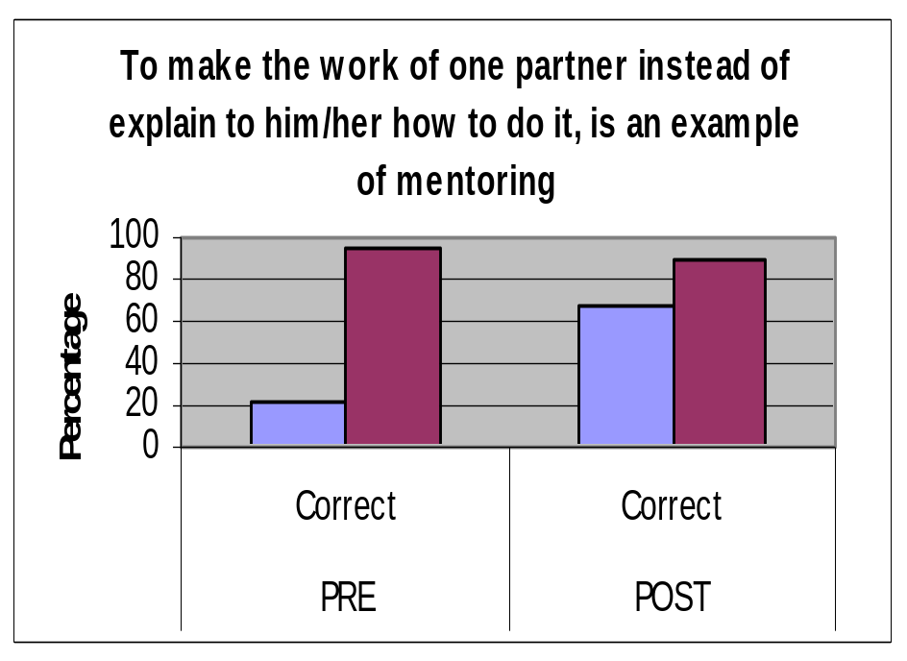
The Assessment: knowledge

Slide 17
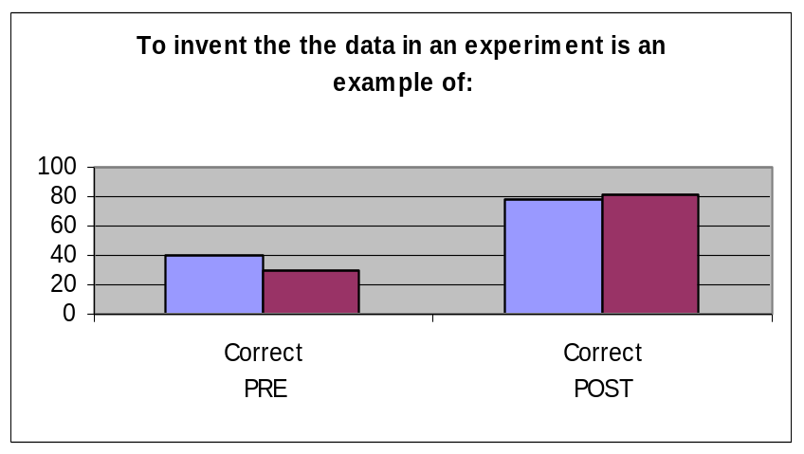
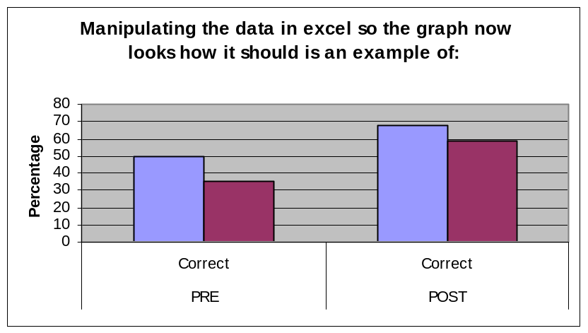
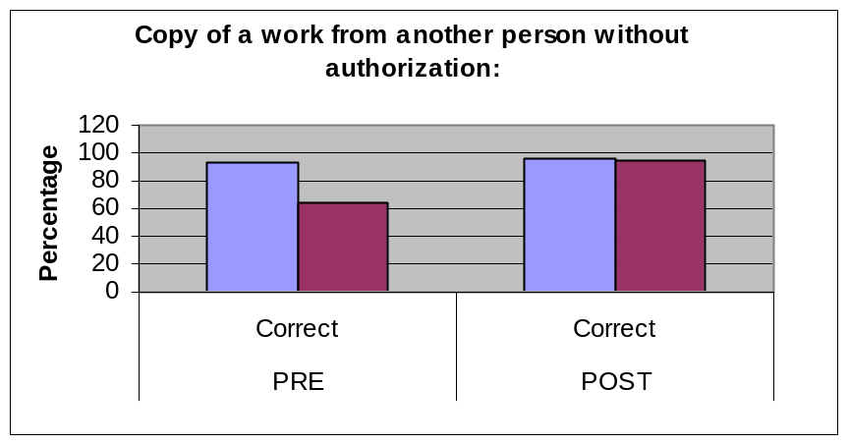
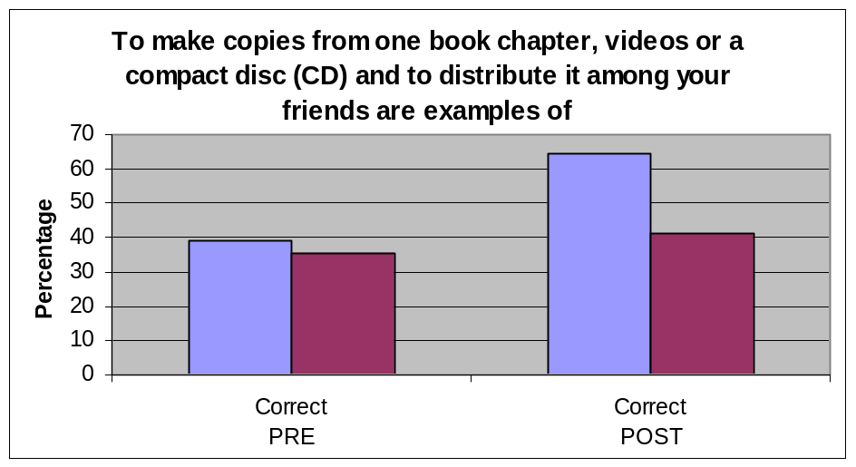
The Assessment: knowledge

Slide 18
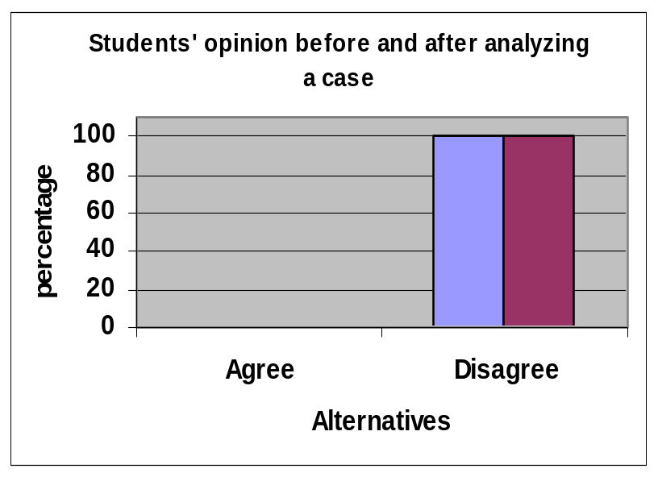
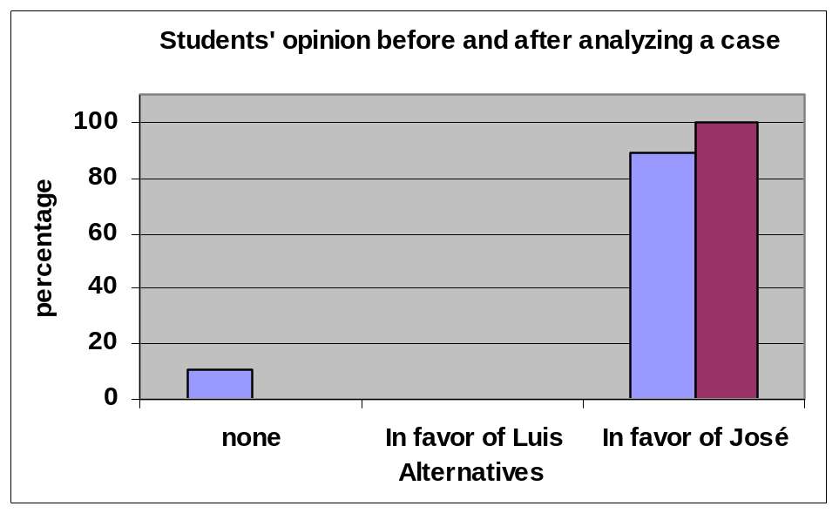
The Assessment: Case analysis

Slide 19
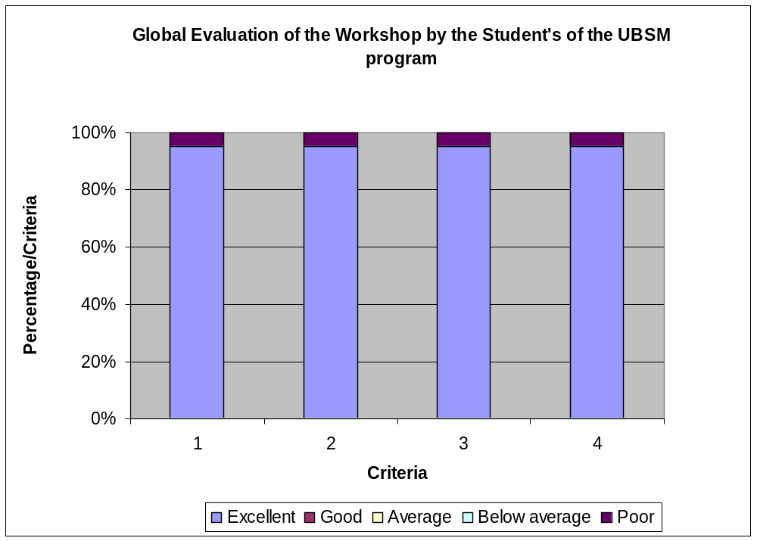
The students enjoyed the experience…
1. The topic was presented…
2. There was a Q&A section…
3. The group participation was…
4. The audiovisual resources were…
5. In general terms the activity was…
Global Workshop Assessment

Slide 20
Some of the videos prepared by
the secondary school
(UBSM) students

Slide 21
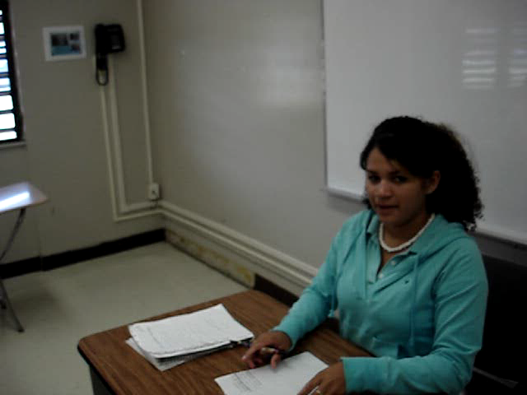

Slide 22
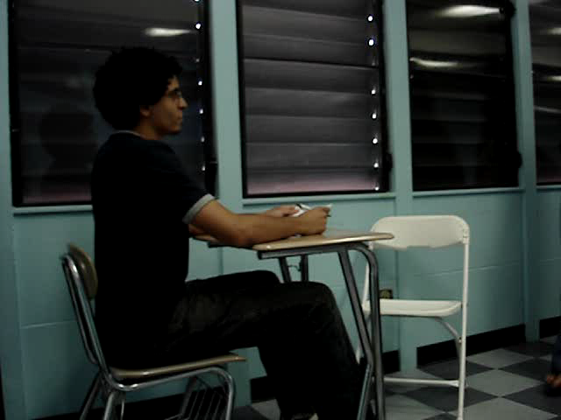

Slide 23
Acknowledgments
GERESE TEAM, especially Erica Jaramillo, Morgan Echeverry,
and Juan B. Rodríguez.
Miss Lorna Enid Muñiz Cruz
Mr. Anardi Antonio Agosto Mujica
NSF 0629377 Graduate Education in Research Ethics
for Scientist and Engineers.
Upward Bound Science and Math program Universidad
Inter American University at Ponce, Puerto Rico.
Summer Transportation Institute 2007. FHWA, ACT and
UPR-Mayagüez.

